Slide 1
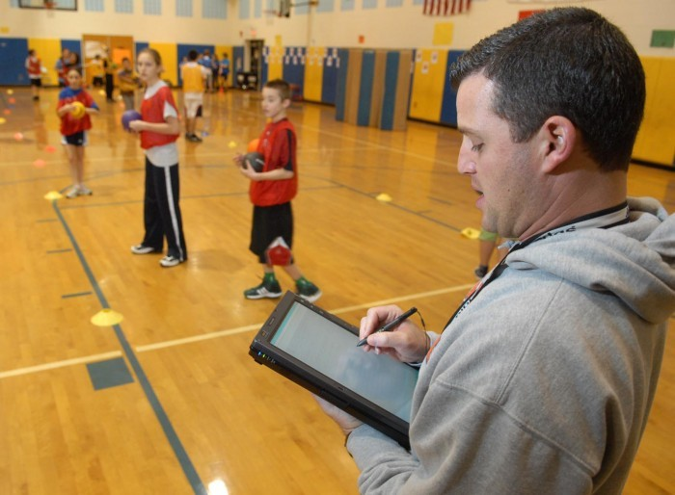
Technology in Physical Education

Slide 2
Benefits of Technology in Physical Education
Teaching and learning with technology has had a significant positive effect on student outcomes when compared with traditional instruction.
As children perform exercises and skills, we can use tools and systems to quantify processes and results to help them learn more about themselves.

Slide 3
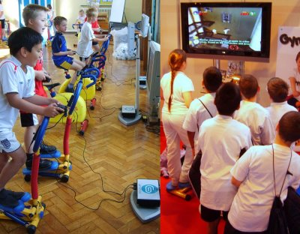
Cont. Benefits of Technology
Students and coaches get instant feedback from the equipment that is used.
Students are continuously using manipulatives and are hands on.

Slide 4
Example of How we use technology in our program
http://www.youtube.com/watch?v=4z9RwPJoyKw
http://www.kidnetic.com/

